Slide 1
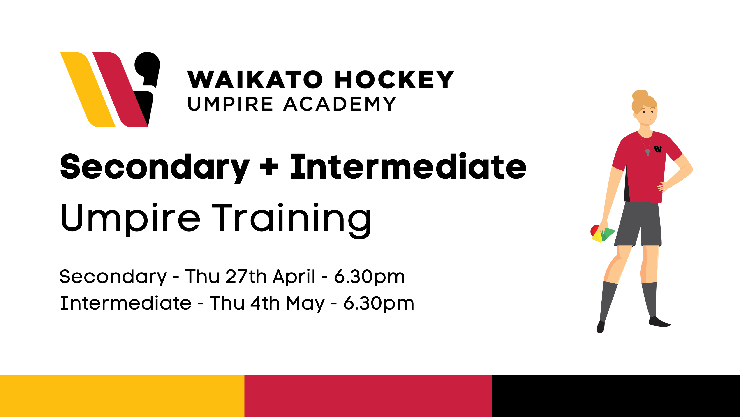

INTRODUCTION TO UMPIRING
A 60-minute crash course into umpiring Intermediate hockey
Notes:
Initial Questions: Who has umpired a game of before? | Who hated it? | Who didn’t mind it? | Who hated it or didn’t mind it, but wanted to know a little more?

Slide 2

Key Learnings
Signals – What are the correct signals
Positioning – Know where to stand
Whistling – How to blow the whistle
Rules – Understand the 5-Basic Rules
Restarting the game – Free Hits, 16s, Long Corners

Slide 3

SIGNALING
How should I look?

Slide 4
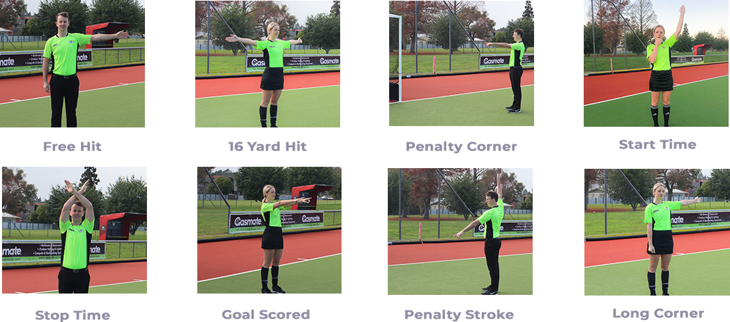
HOW TO SIGNAL?

Slide 5
5 BASIC RULES
What to remember?

Slide 6
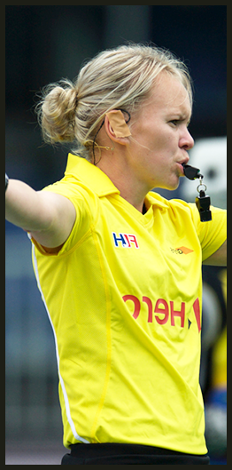
5 BASIC RULES
Feet / Body
Tackles – Stick Obstruction
Tackles – Body Contact
Obstruction
Dangerous Ball

Slide 7
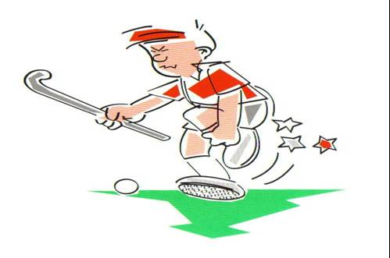
1. FEET / BODY
Players must not play the ball with any part of their body.

Slide 8
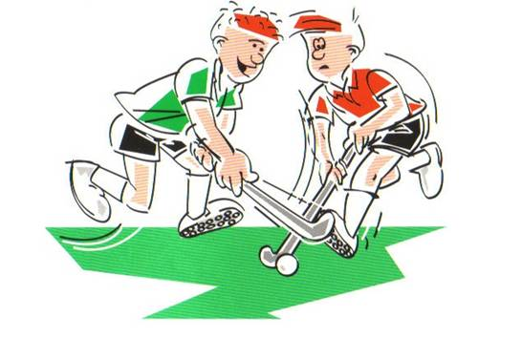
2.TACKLES – Stick Obstruction
Tacklers must play the ball and not the sick.

Slide 9
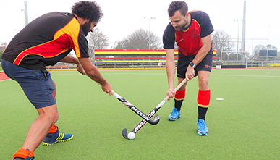
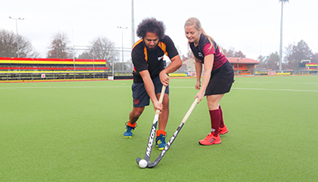


PLAYING THE BALL, NOT THE STICK
This is a stick check or hack by the tackler. Free hit to the attacker.
The tackler has played the ball cleanly.
The call is play on.

Slide 10
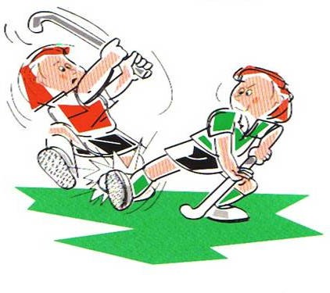
3. TACKLES – Body Contact
Defenders must not tackle unless in a position to play the ball without body contact.
Sliding and overly physical tackles are not allowed.

Slide 11
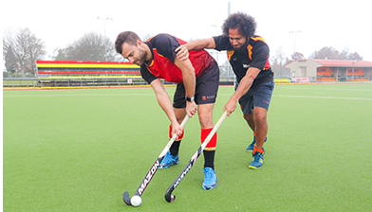
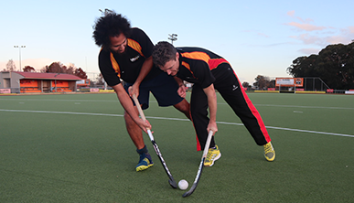
PLAYING THE BODY
There is a push from the tackler.
Free hit to the attacker.
There is a push from the tackler.
Free hit to the attacker.

Slide 12
POSITIONING
Where does the umpire stand?

Slide 13
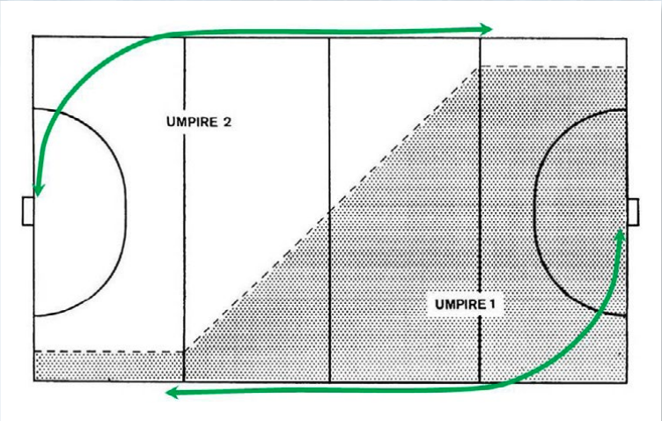
WHERE TO STAND
UMPIRE A
Basic rules
Free hits
Penalty corners
UMPIRE B
Each umpire has one half of the field and one circle.
Areas on the edge of each umpire’s zone are shared.
Umpires work as a team, but don’t blow in the others area.

Slide 14
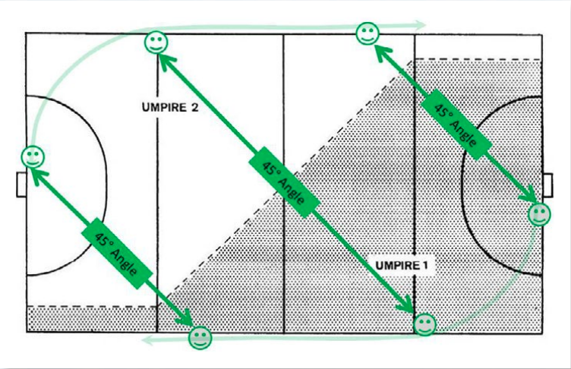
BE IN THE FRAME!
Try to stay at a 45 degree angle to the play.
Stay ahead of the play as it comes to your circle
Follow the play as it travels up the field.

Slide 15
POSITIONING
GAME 1. THREE POST ITS

Slide 16
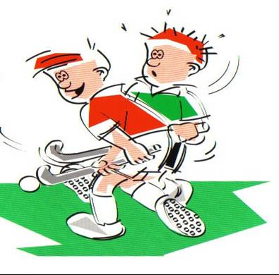
4. OBSTRUCTION
Players must not obstruct an opponent who is attempting to play the ball

Slide 17
4. THREE TYPES OF OBSTRUCTION
Players obstruct if they:
  1. Back into an opponent
  2. Shield the ball with their stick of body
  3. Runs in front or blocks an opponent (third party)

Slide 18
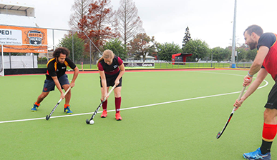
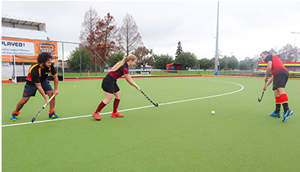
OBSTRUCTION
The attacker can receive the ball
facing their own goal
The attacker has moved the ball away
cleanly to make a pass

Slide 19
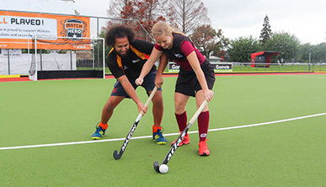
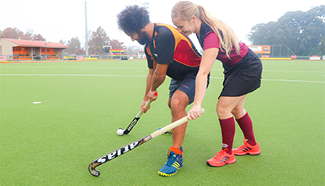
OBSTRUCTION
The attacker has backed into the defender
blocking a fair tackle.
The attacker is using his body to block
a fair tackle from the defender.

Slide 20
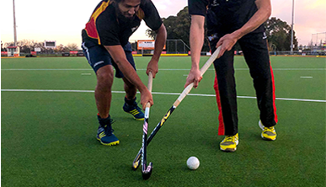
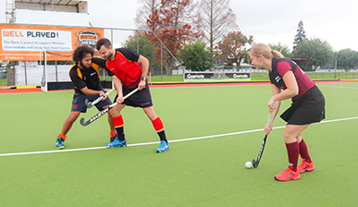
OBSTRUCTION – Backing in
The attacker has used their stick to
shield the ball from a fair tackle
The attacker as blocked the defender
from making a fair tackle

Slide 21
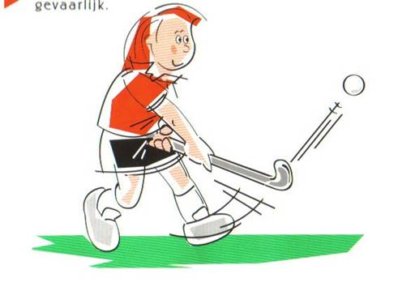
5. RAISED AND DANGEROUS BALL
A ball that can cause or lead to danger should be penalised
Danger = Legitimate Evasive Action
Generally speaking
  Below the knee = Ok
  Above the knee = Not ok

Slide 22
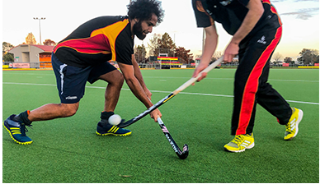
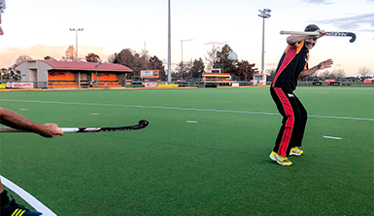
RAISED AND DANGEROUS BALL
This ball is raised safely and skillfully
over the defenders stick.
This ball is raised dangerously
toward the defender.

Slide 23
FREE HITS
How do we restart the game?

Slide 24
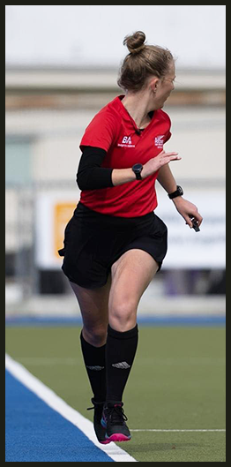
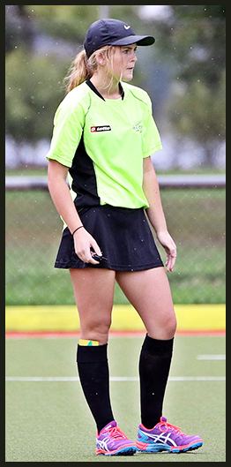
FREE HITS – 4 Things to Remember
1. Location
  Must be taken close to where the offence occurred.
2. Ball Stopped
  Players must make an attempt to stop the ball.
3. 5m
  Defenders must be 5m from the ball
4. Auto Pass
  Remember players can “tap and go” by auto passing to themselves

Slide 25
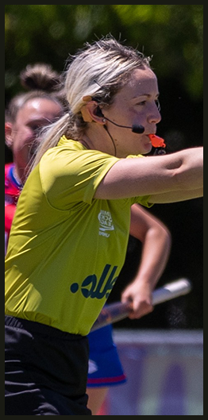
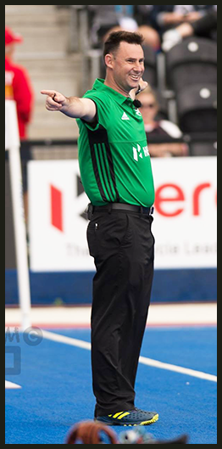
BALL OVER THE BACKLINE
Last touched by an attacker
  A 16 yard hit is taken by defenders
  In line with the top of the circle and where the ball went out
Last touched by a defender
  A long corner is taken by attackers
  In line with the 16m/5m line at top of the circle and where the ball went out
Ball played deliberately over the backline by a defender = Penalty Corner
Notes:
Make into a game: Last one to make the signal sits down.

Slide 26
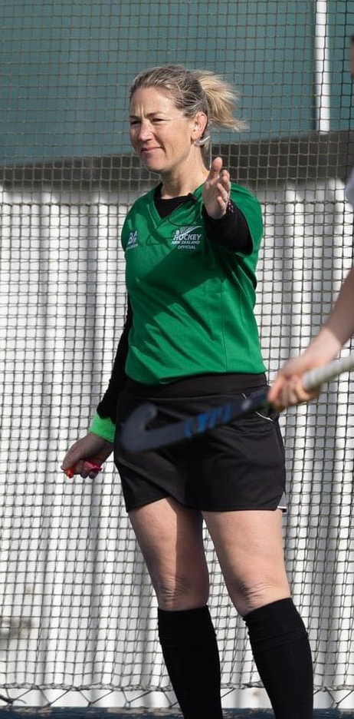
FREE HITS – Within 5m of the circle
Must not be played straight into circle
  The ball must travel 5m before being played into the circle,
  Or be touched by a defender

Slide 27
THE WHISTLE
How should it sound?

Slide 28
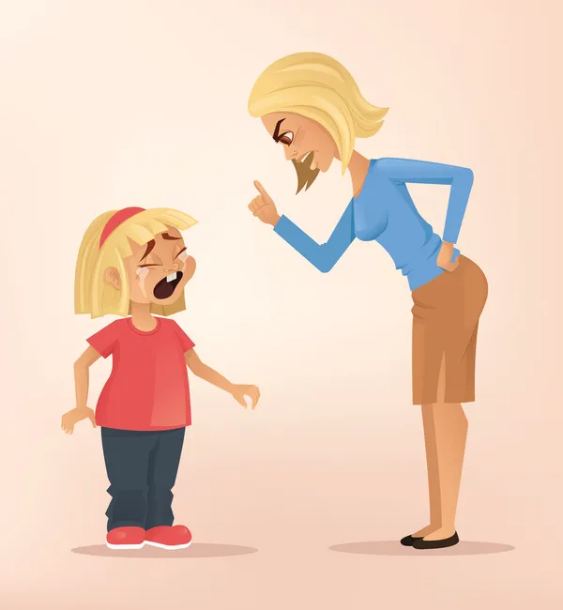
BLOWING THE WHISTLE

Slide 29
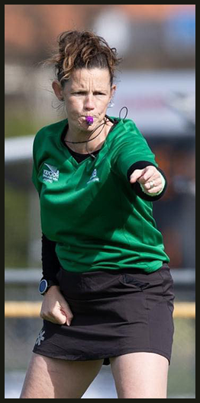
BLOWING THE WHISTLE
Main way which umpires communicate with teams
Must be blown loudly and clearly
Tone and duration of the whistle must vary to communicate how bad the offence is.
Recommend using a Fox40 Classic, or Fox40 Mini
Available at Just Hockey and Rebel Sport

Slide 30
Penalty Corners
Managing set plays

Slide 31
INTERMEDIATE GRADES – 6 A SIDE
No penalty strokes
Long corners taken from 5m line, top of circle
PCs – Three defenders start from opposition circle
Without a Goal Keeper
  Ball must not be raised above the shin pad
  Ball must hit the backboard at a PC

Slide 32
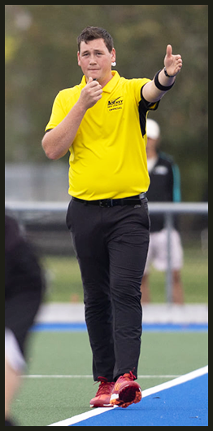
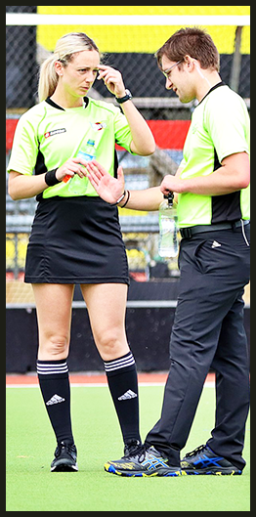
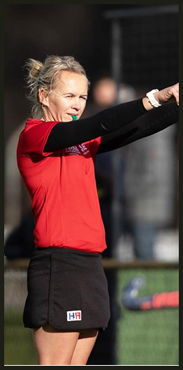
PENALTY CORNERS
Are awarded for offences by defenders inside the circle
Taking a PC
  Ball is placed on the backline – 10m mark
  3/5 defenders in the goal and behind the line + goalie
  All other defenders, opposition circle/Halfway
  All attackers outside the circle

Slide 33
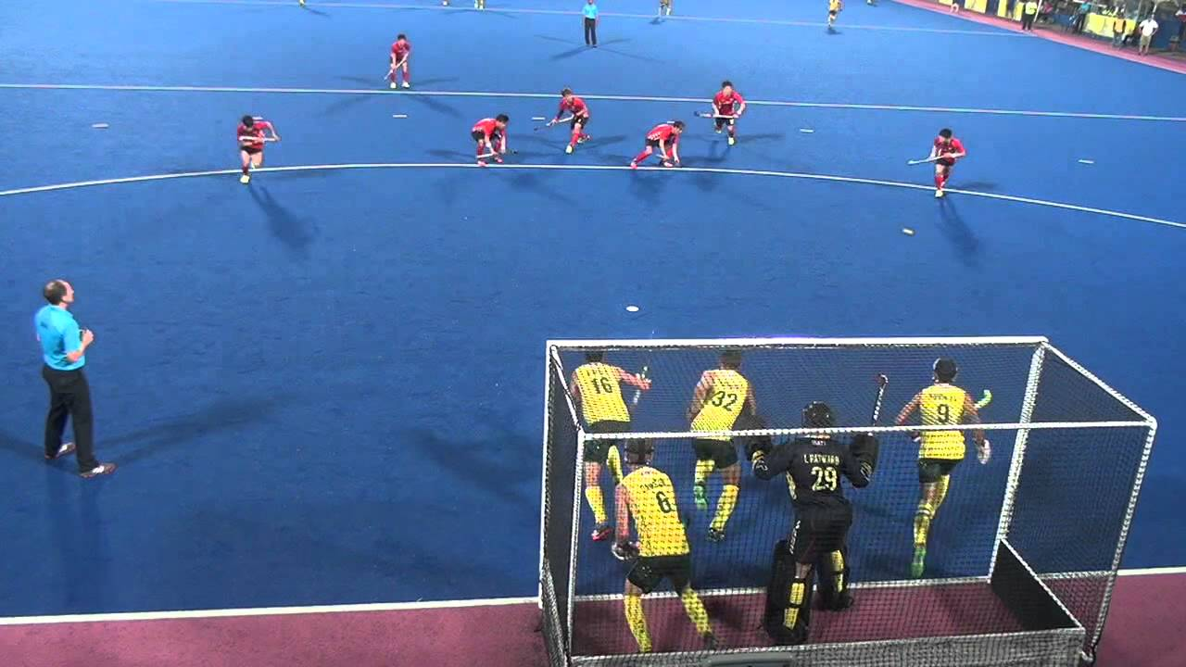
PENALTY CORNERS
Breaking
The defenders may not break the goal line or the attackers the circle edge until the ball is dragged out.
  Defender breaks
  = Back to halfway
  Attacker breaks the circle edge
  = Dragger to halfway

Slide 34
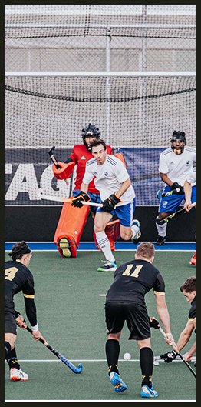
PENALTY CORNERS
Above/Below the backboard
  If the ball is hit, it must be below the height of the backboard
  If the ball is scooped or flicked, it can go at any height
  Second shots at goal can be at any height.
Ball hits the first runner
  On or above the knee – Free hit to defense
  Below the knee – Another PC
A goal cannot be scored until the ball has travelled outside the circle

Slide 35
ADVANTAGE
Letting the game flow

Slide 36
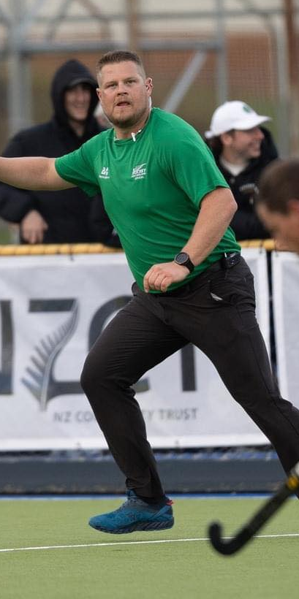
ADVANTAGE
What is advantage?
Letting the game continue when:
  A team still has possession
  Is able to develop their play
When is advantage over?
  After a fair chance to develop their play
  A second opportunity must not be given by reverting back to the original penalty
  E.G A second shot at goal, attackers lose the ball

Slide 37
CONTROL
Keeping the game safe and fair

Slide 38
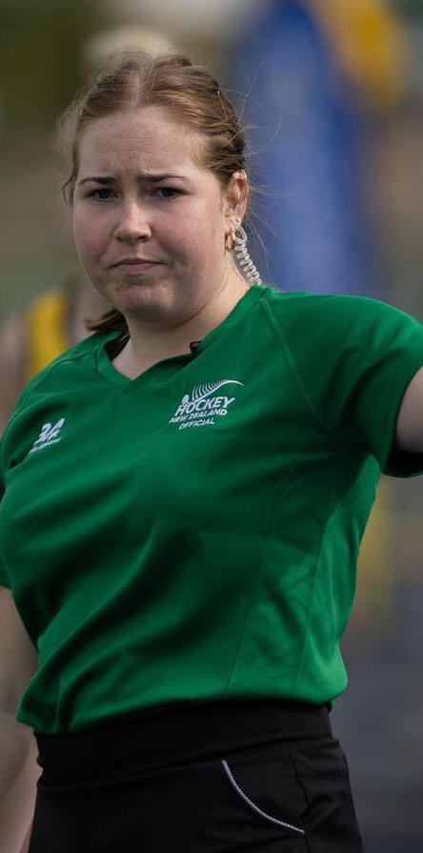
CONTROL
Abuse & Physical & Dangerous Play
Any abuse, overly physical fouls or dangerous play should be dealt with harshly with cards
  Sliding tackles
  Aggressive body checks
  Abuse of opponents or umpires by any participant (including coaches)
Green Card = 2min Suspension
Yellow Card = 5 or 10min Suspension
Speak to a parent, coach, manager

Slide 39
WHAT NEXT?

Slide 40


Slide 41


Slide 42
